Slide 1
EECS 396: Data Science Seminar
Final Presentation
Investigation on the Effect of Identity in the CPDB
Casey Grage & Renee Zha
Group 10

Slide 2
Theme
​Examine if there are trends in allegations/complaints/cases between identity groups of civilians, identity groups of officers, and relationships between identity groups of officers and civilians.
An “identity group” is a group of people that have the same race, gender, age. We will need all three of these factors to determine a person’s identity group.
Notes:
Renee

Slide 3






Tools
Notes:
Renee

Slide 4
Initial CPDB Exploration
Demographics of complaint reports
Black individuals filed the most overall complaints against CPDB officers
They were also the most common victims in complaint reports
gender | race | count
--------+--------------------------------+-------
M | Black | 36856
F | Black | 22342
M | White | 7384
M | Hispanic | 7017
F | White | 4990
F | Hispanic | 3585
Officers with multiple allegations
87.6% of officers with allegations against them had multiple (59.4% of total force)
89.9% of officers with allegations that included a victim had multiple (31.6% of total force)
Notes:
Renee

Slide 5
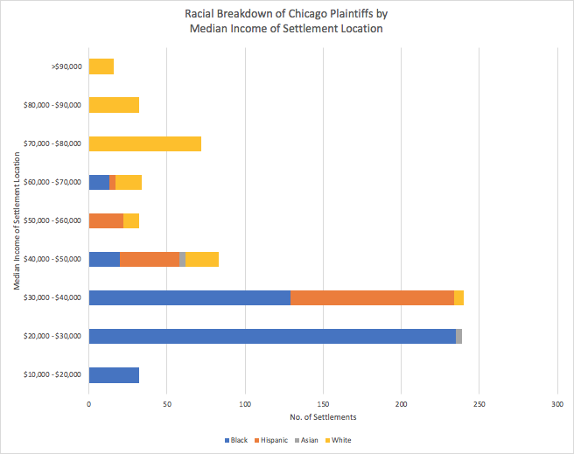
Data Integration
Incorporating location, demographic, and income information:
The majority of settlements occur in lower-income areas ($20k-$40k median income)
In higher income areas, black officers were more likely to have an allegation against them than white officers compared to the general population
Opposite was seen in lower income areas
Small/nonexistent sample size for other races
Notes:
Casey

Slide 6
Workflow Analytics
Investigate how the percentage of complaints against officers of different races compares to the overall demographics of the CPD over time
Investigate how the race of the police investigator affects the outcome of the complaint (disciplined or not)
Investigator and officer are the same race
Investigator and victim are the same race
Investigator and complainant are the same race
Notes:
Renee

Slide 7
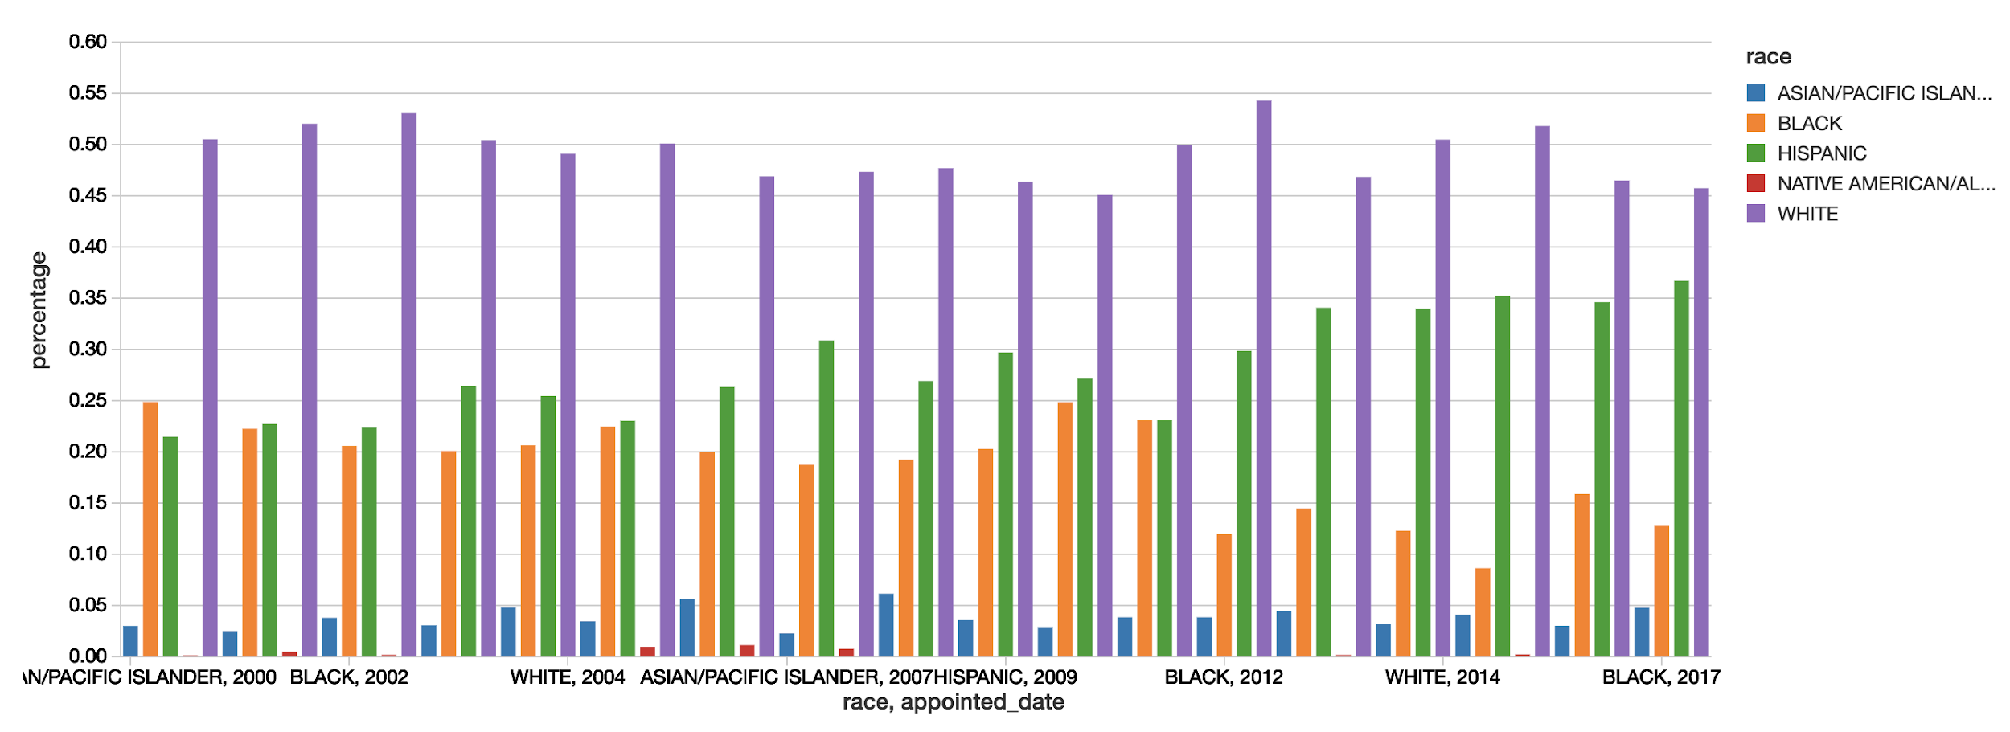
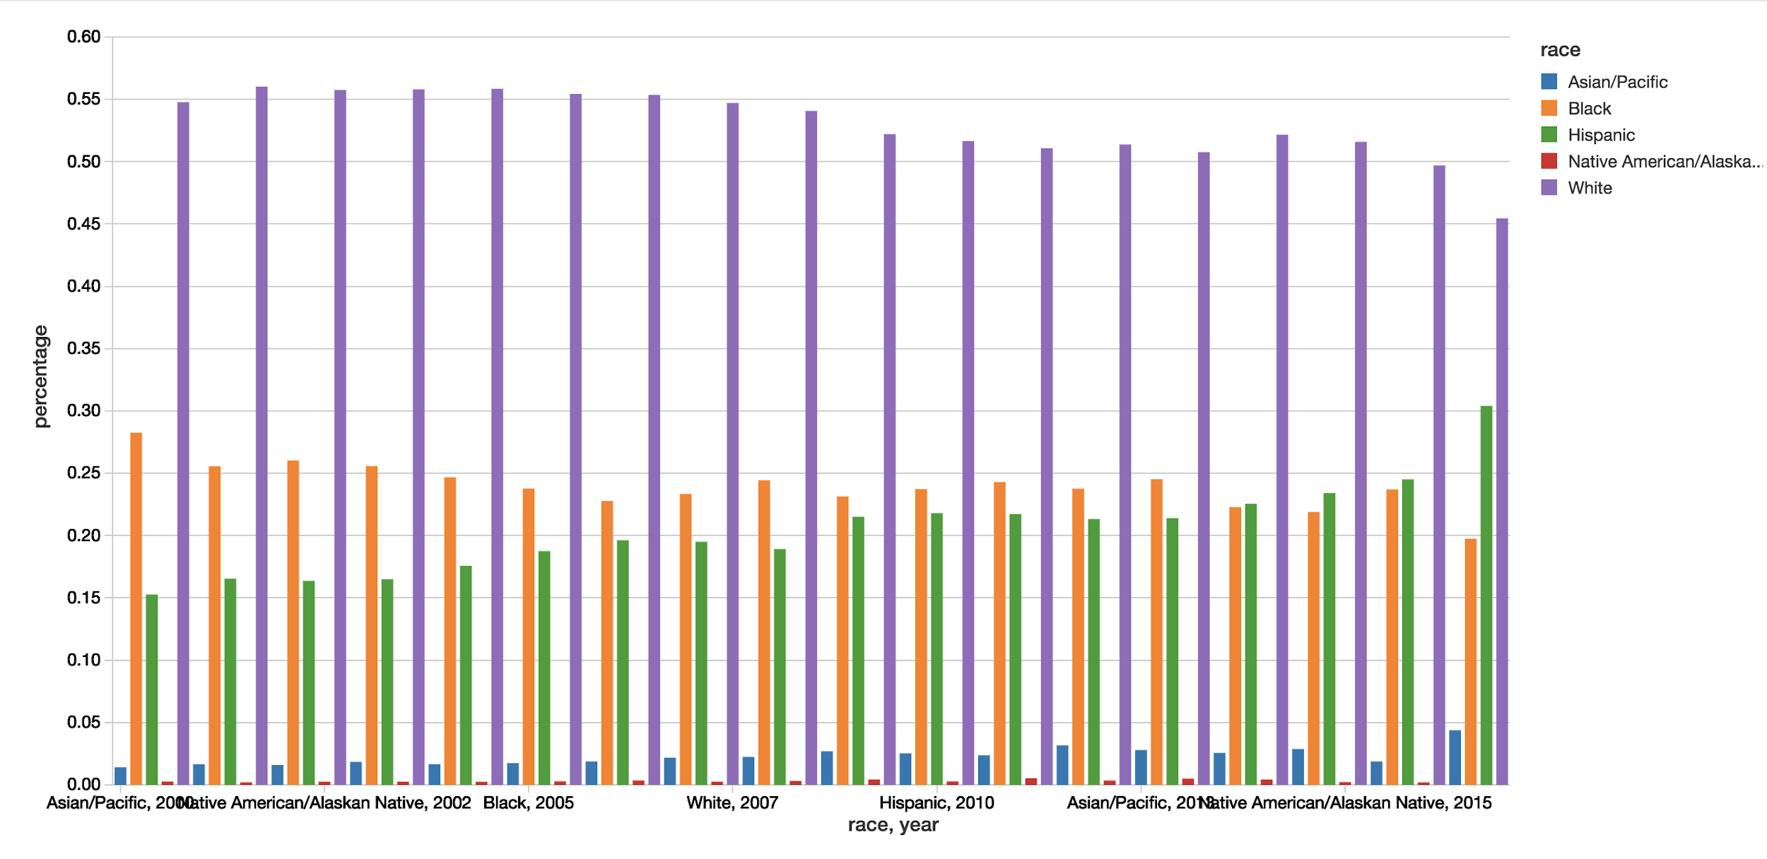
% Allegations Against Officers By Race and Year
(2000-2017)
CPD Racial Breakdown By Year (2000-2017)

Slide 8
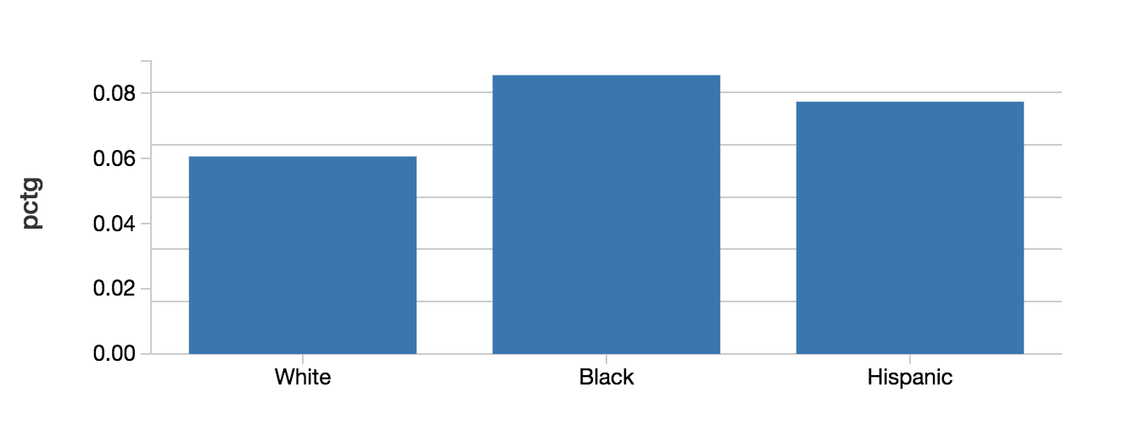
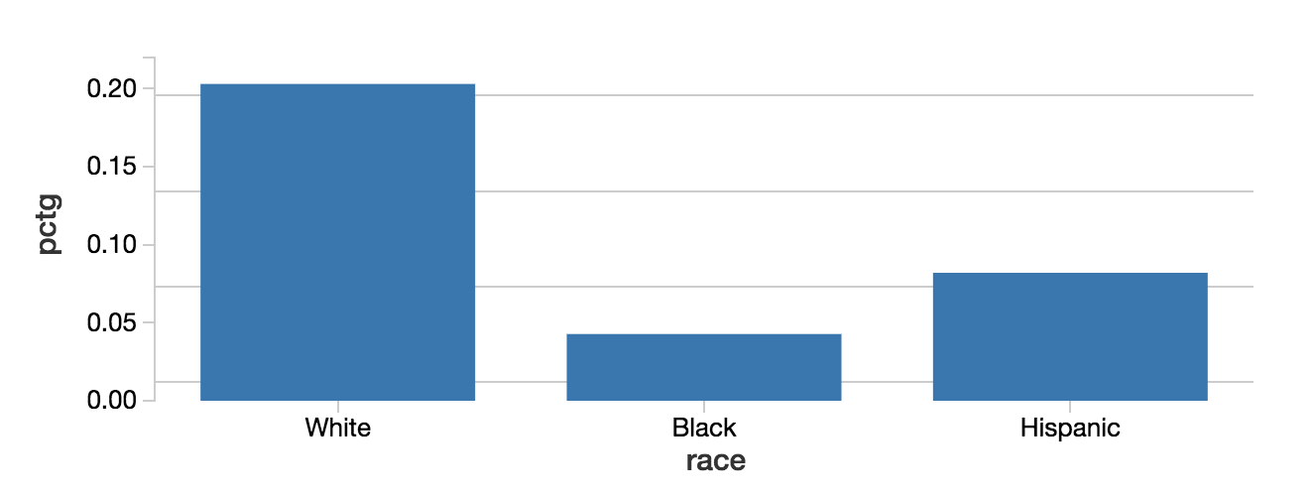
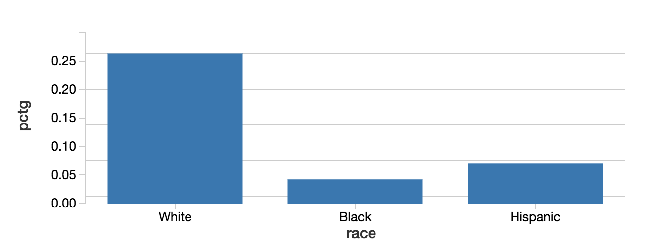
% Officers Disciplined by Investigators of the Same Race
% Investigators Working with Victims of the Same Race
% Investigators Working with Complainants of the Same Race

Slide 9
Machine Learning
Can we predict how the rate of complaints that result in disciplinary action change over time? Does this model get better or worse with added demographic data about the officers and complainants?
Used linear regressions
No we can’t
What features are most importance for predicting subject identities? Predicting officer identities? Methodology:
Chose likely important features
Use SQL in terminal to get data
Joined more data in databricks
Turned variables into bools
Used OneHotEncoding to encode categorical data
Created 6 random forest classifiers to predict each identity
Notes:
Casey

Slide 10
Machine Learning cont.
What features are most importance for predicting subject identities? Predicting officer identities? Results:
Subject Gender: officer_gender, officer_in_uniform, weapon_discharged
Subject Race: lat/lon, officer_on_duty, offier_age
Subject Combo: lat/lon, officer_gender, officer_age
Officer Gender: subject_gender, officer_in_uniform, officer_assigned_beat
Officer Race: lat/lon, subject_race, officer_rank
Officer Combo: lat/lon, subject_gender, subject_race

Slide 11
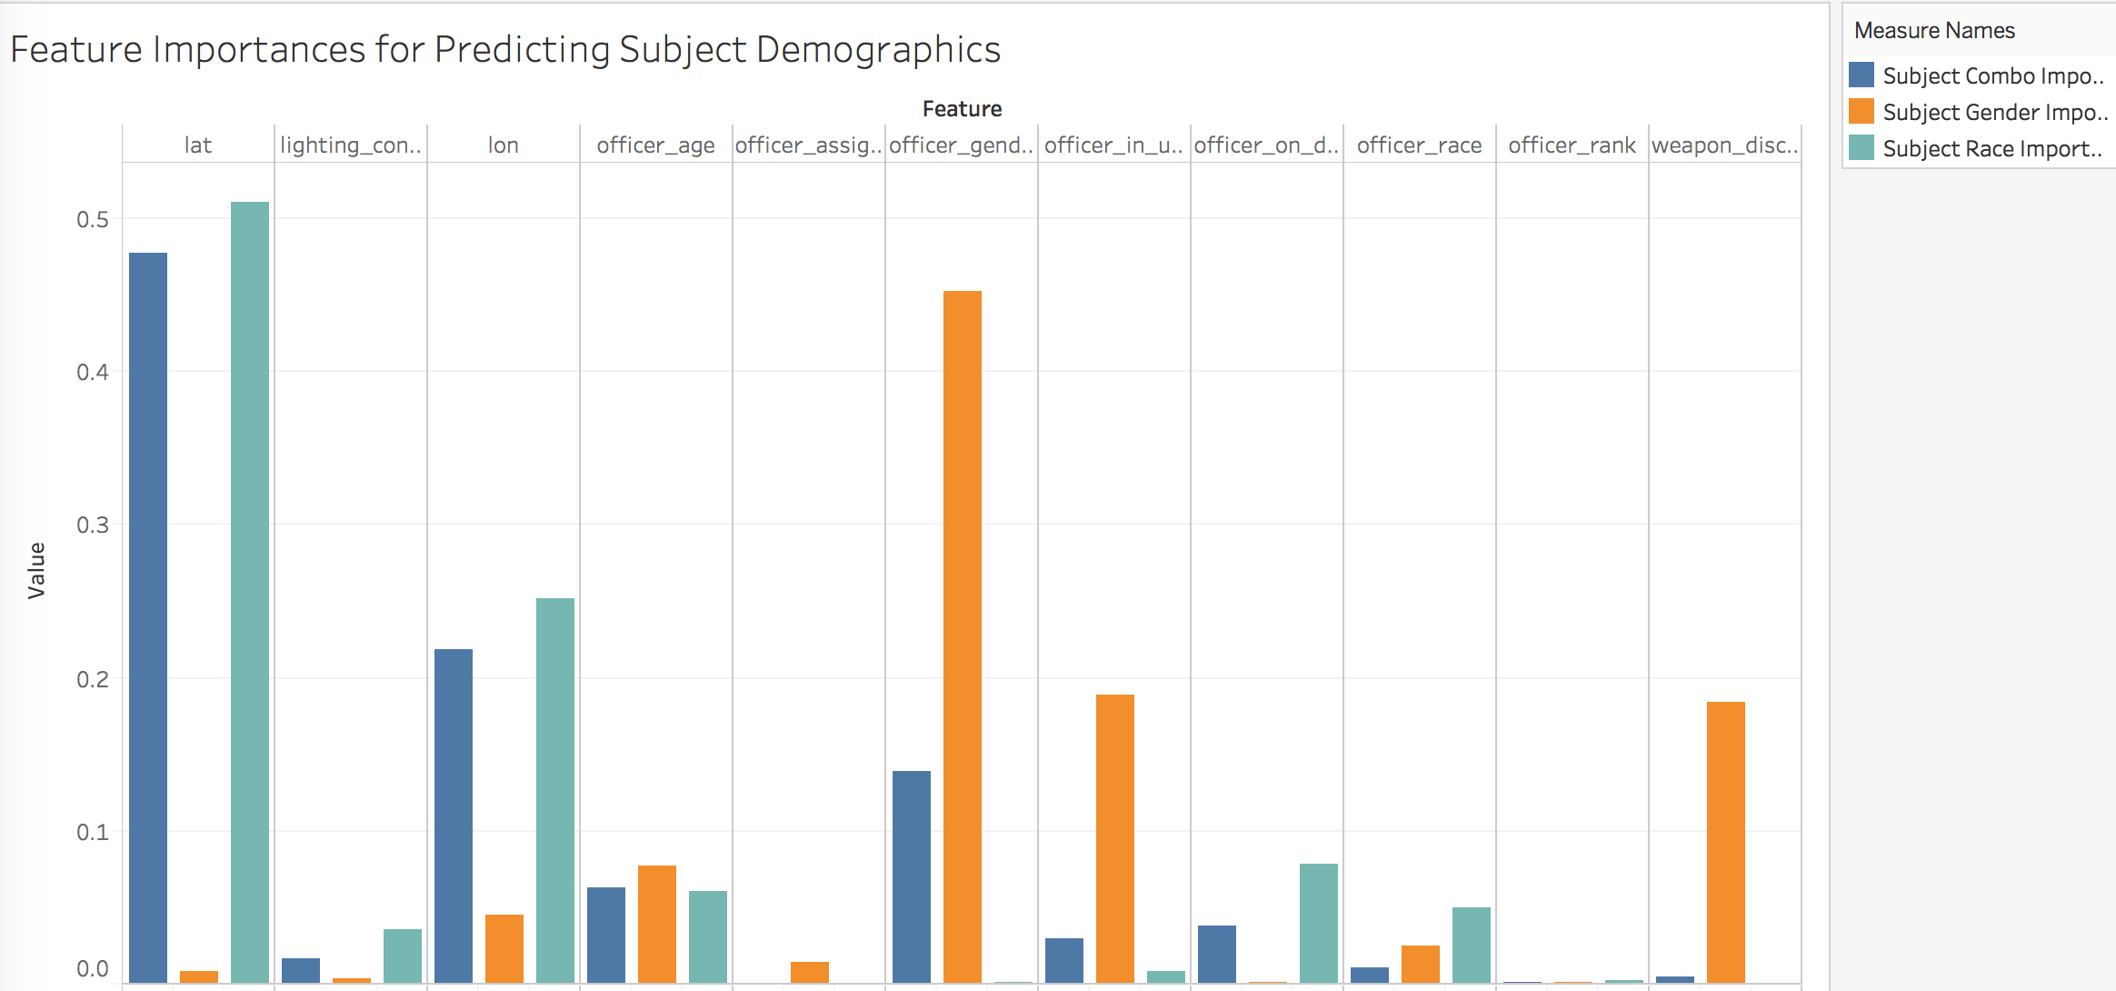

Slide 12
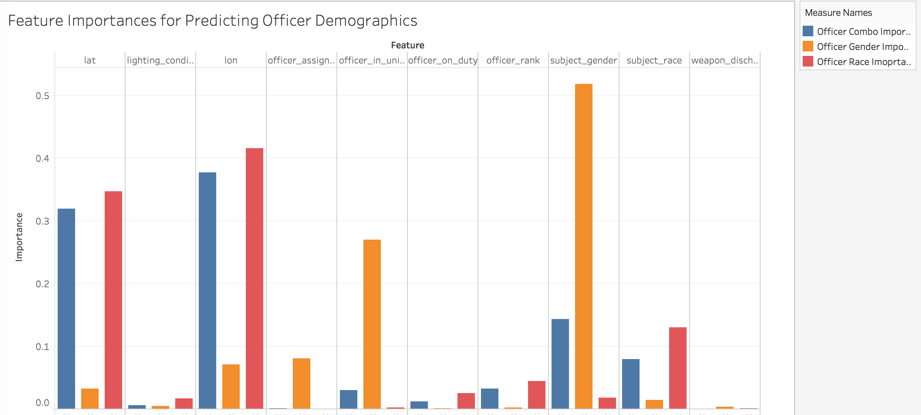

Slide 13
Text Analysis with Tensorflow
Settlement narratives: “Woods and Terrell were in the South Shore neighborhood when...officers stopped… and arrested Terrell without reason...While Terrell was in custody,...hit...in the face multiple times...To cover their misconduct, the officers charged Woods with aggravated battery...He was found not guilty of this charge.”
Built model to classify the race of officers involved in settlement cases given the text of a narrative
Interested in if the patterns in narratives changed based on the identity group of involved officers
MLP model using unigram and bigram tokenization: ~60% accuracy
Relatively small set of data, and unbalanced in terms of demographics
Investigate other models and text analysis techniques (word embeddings, etc.)
Notes:
Renee

Slide 14
Visualization
Used SQL to creates tables
Make sure to account for demographic makeup of CPD (or Chicago) for comparisons!
Instead of using Count use %
Interesting Results:
White women are actually the most likely to have an allegation
^ Followed by white men, black men, black women
Men are more likely to file complaints in almost every category
except for lockup procedures and criminal misconduct
White men are most likely to have an allegation for every category but drug abuse
Notes:
Casey

Slide 15
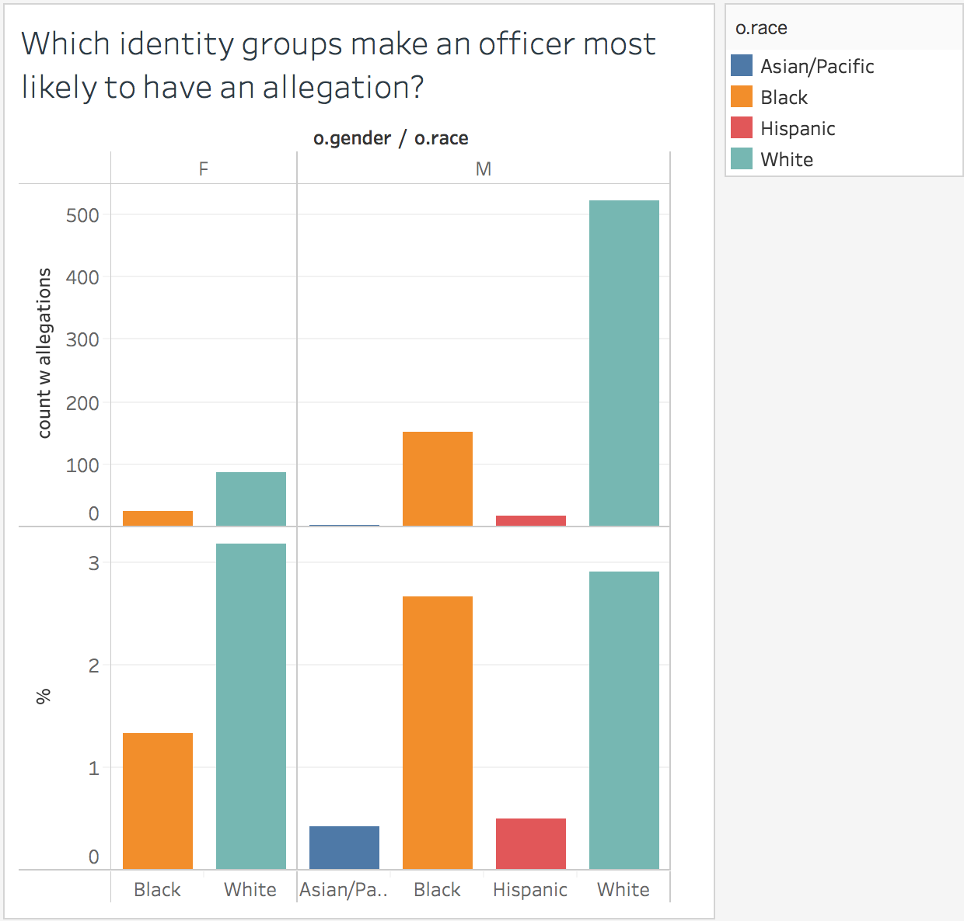
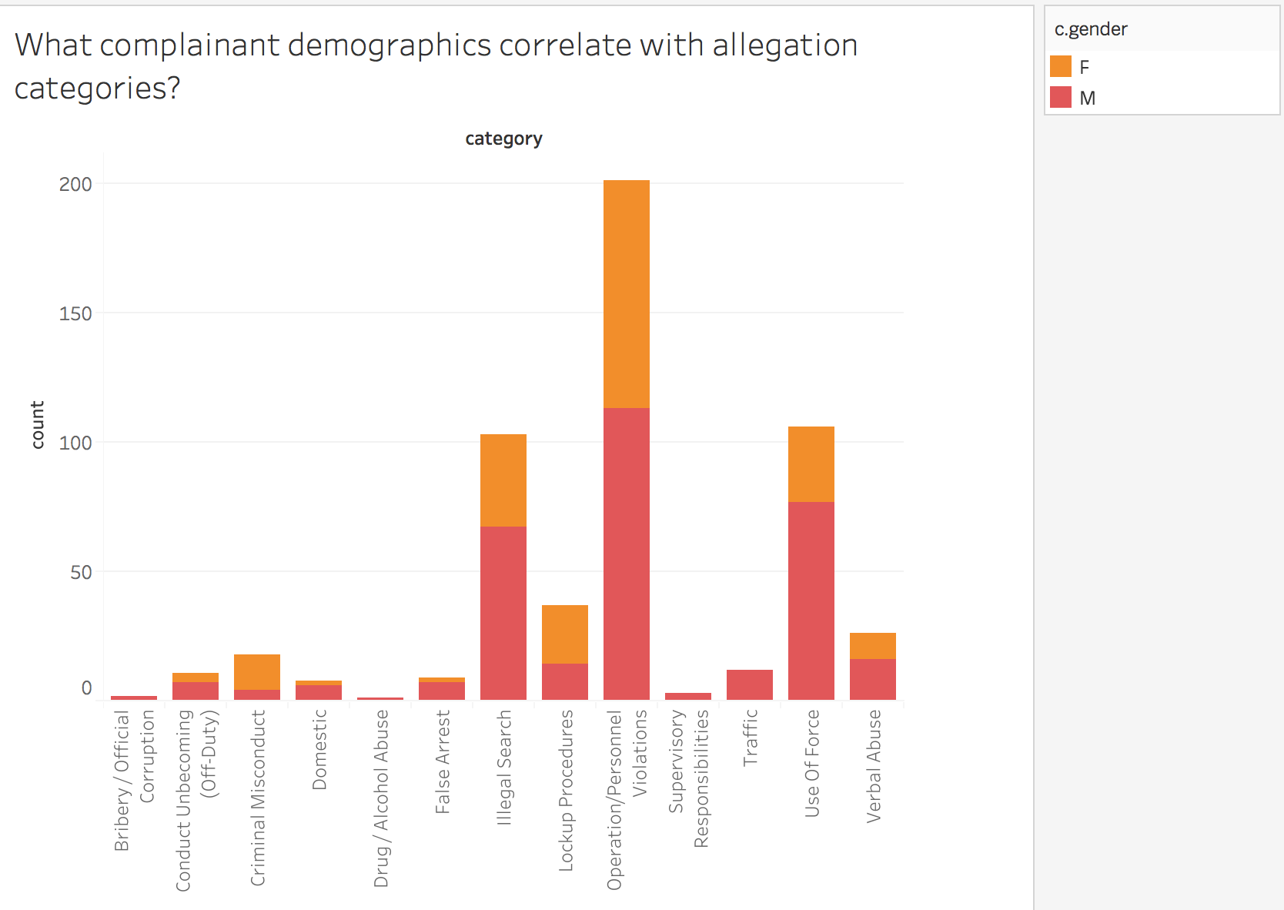
The graph to the left shows both the counts and percentages of officers with allegations.

Slide 16
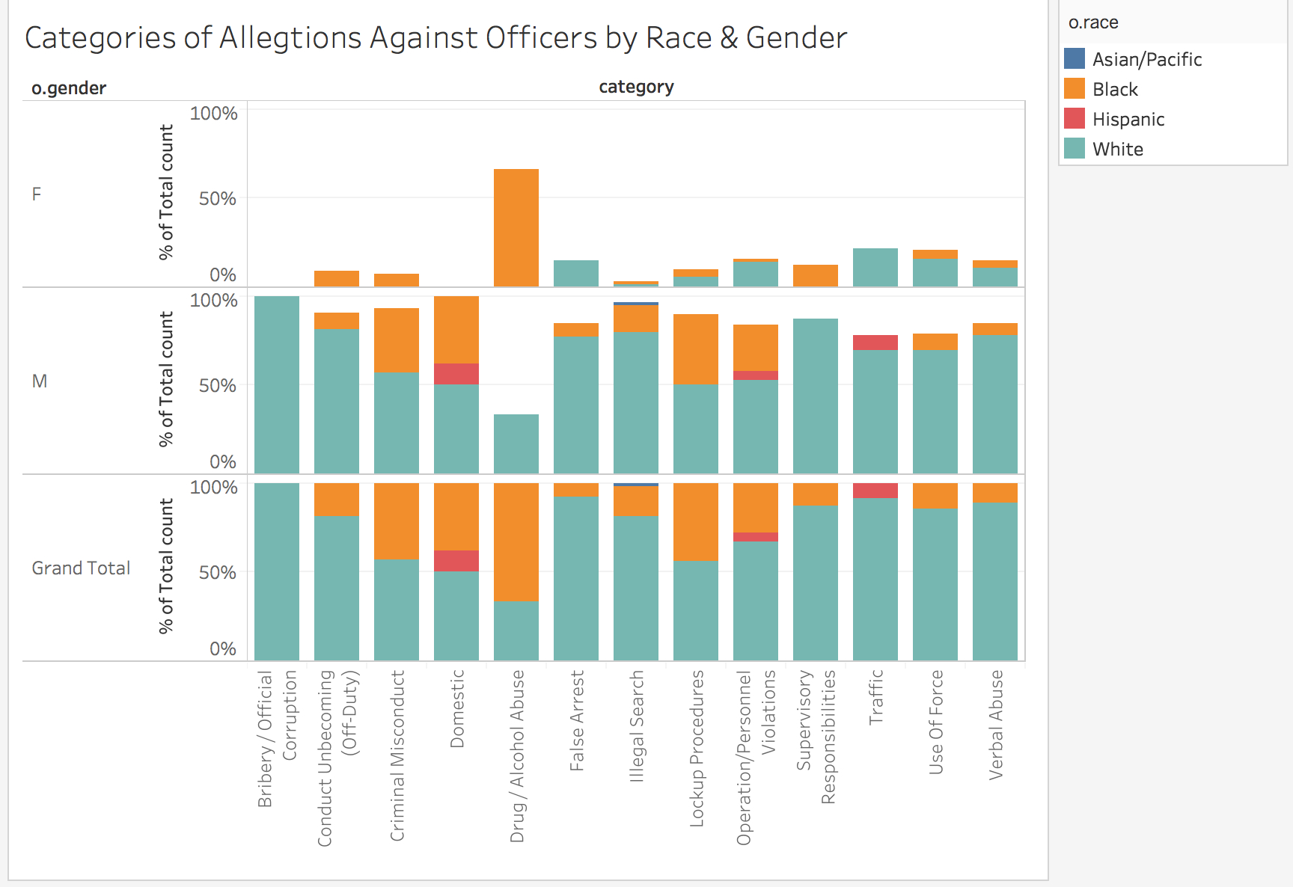

Slide 17
Conclusions
Findings confirmed suspicions that there were inequalities in how individuals of different identity groups were treated that did not match overall demographics of the populations. More rigorous statistical analysis needs to be conducted to infer stronger correlations.
With respect to machine learning models, location and subject identities are most likely predictors of officer identities and vice versa. However, we had difficulties in building accurate machine learning models to tokenize text. We may need to explore more features in the data.

Slide 18
Thank you!
Questions?

